Slide 1
C2P India
QA Track

Slide 2
Introduction and Agenda
Using JIRA
Bug Life Cycle
Bug Logging guidelines

Slide 3
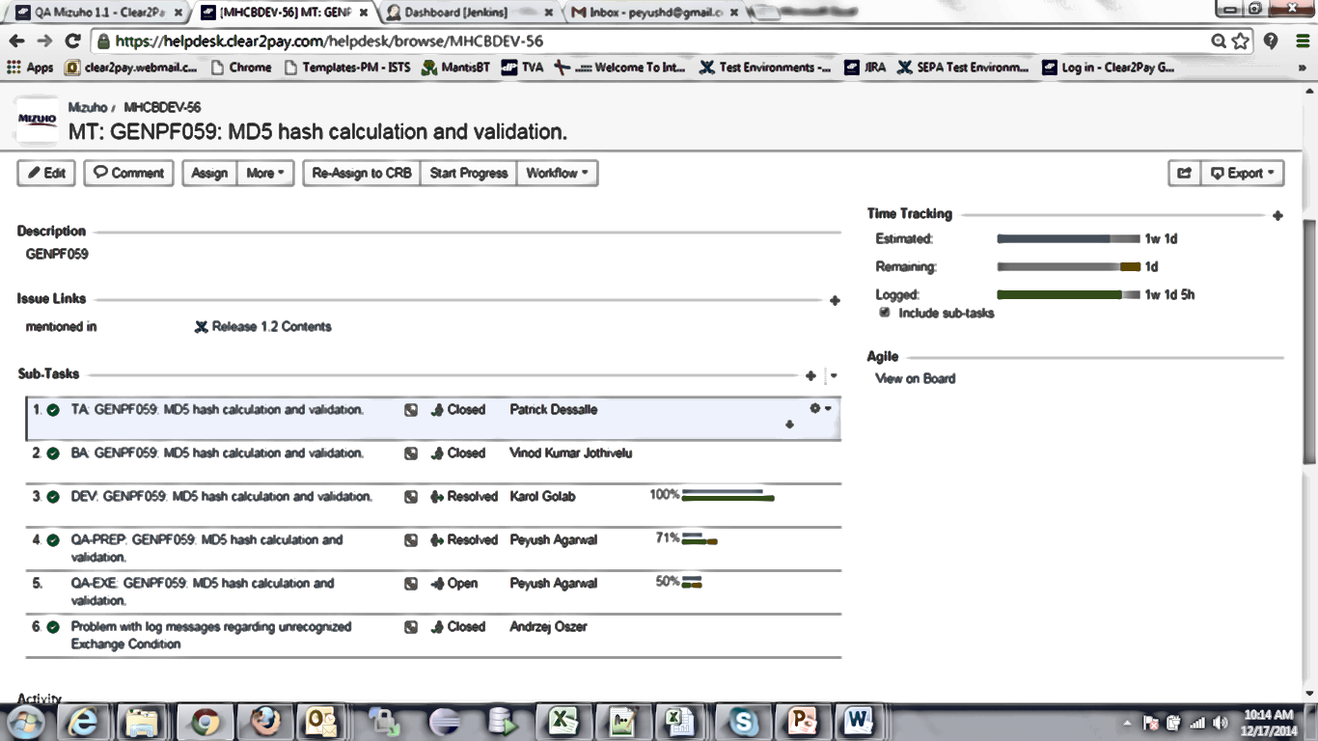
JIRA and different QA Task States
JIRA is being used across all Projects/Products in C2P by QA,Dev, TA & BA for Task related to Project features
Login to following link with your System credentials:
https://helpdesk.clear2pay.com/helpdesk/
For any features, a Main Task is created and then BA, TA and Dev will create their respective sub-task within that Main Task. QA creates 2 types of Sub-Task : QA-Prep and QA-Exe

Slide 4
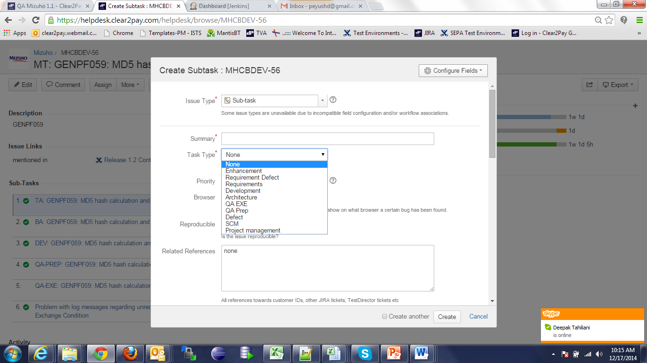
QA-Prep JIRA
The above task are created by respective Leads in all the projects. In order to create a sub-task, open the Main task in JIRA, Click on more – Create Sub-task and following screen will come up. For QA Prep task, we have to select Task Type as QA Prep

Slide 5
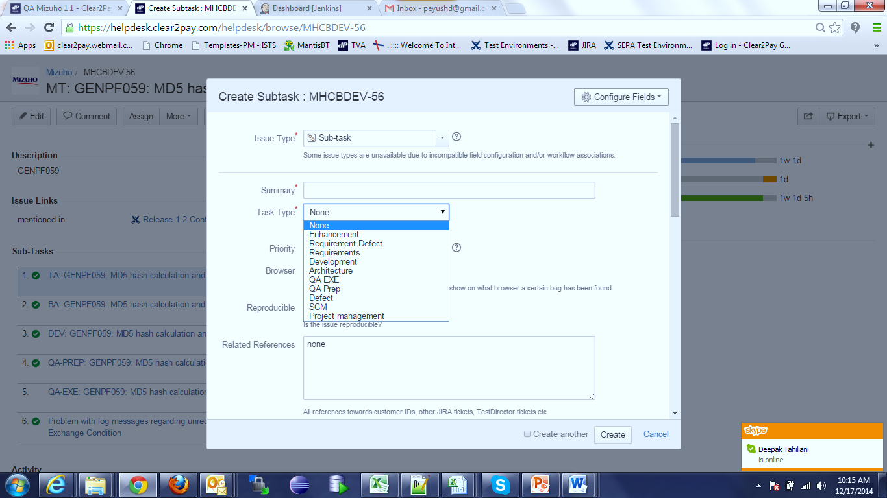
QA-EXE JIRA
The above task are created by respective Leads in all the projects. In order to create a sub-task, open the Main task in JIRA, Click on more – Create Sub-task and following screen will come up. For QA EXE task, we have to select Task Type as QA EXE

Slide 6
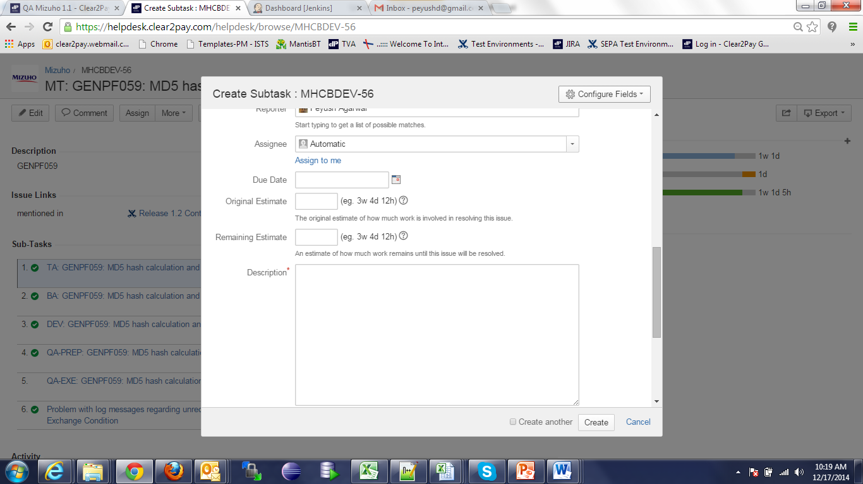
JIRA and different QA Task States
While creating the sub-task for Prep or Exe, we need to enter Original Estimate value which can be taken from Project Estimate sheet or form the Change Request document.

Slide 7
QA Prep Task States
Once the Prep and Exe Sub task are created, we need to move the status of Task. The various stages involved of QA-Prep is shown below and Exe task (next slide). Resource needs to move the stage of Task once assigned by TL.
New
Open
In progress
Review
Closed

Slide 8
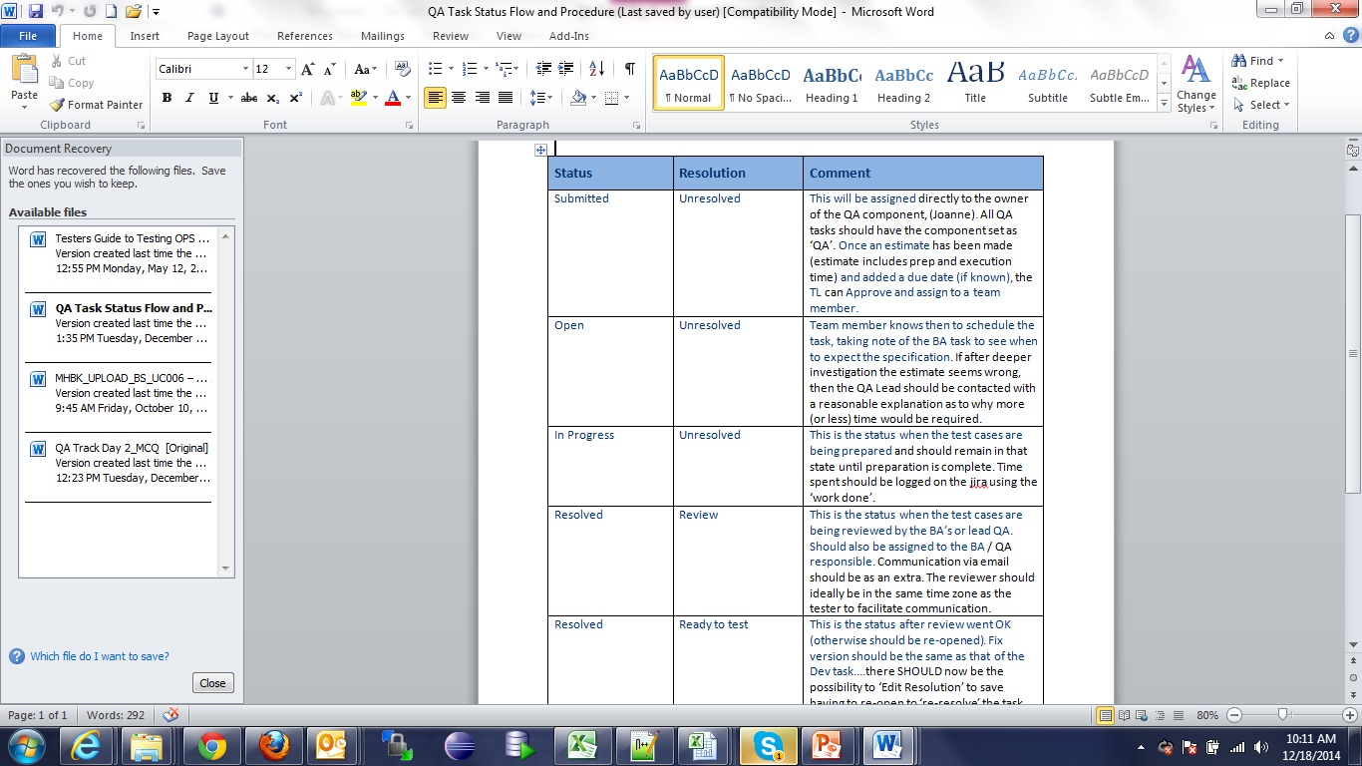
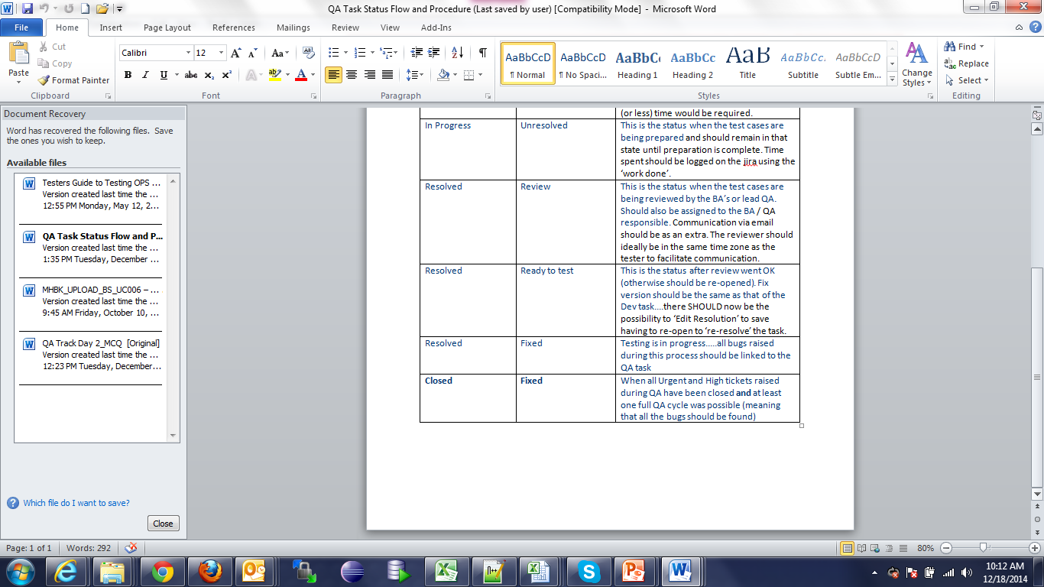
JIRA and different QA Task States
Below is the snapshot of brief description of various stages of Sub-Task:

Slide 9
QA EXE Task States
The various stages involved for QA Exe task is shown below. Resource needs to move the stage of Task once assigned by TL.
New
Open
In progress
Closed

Slide 10
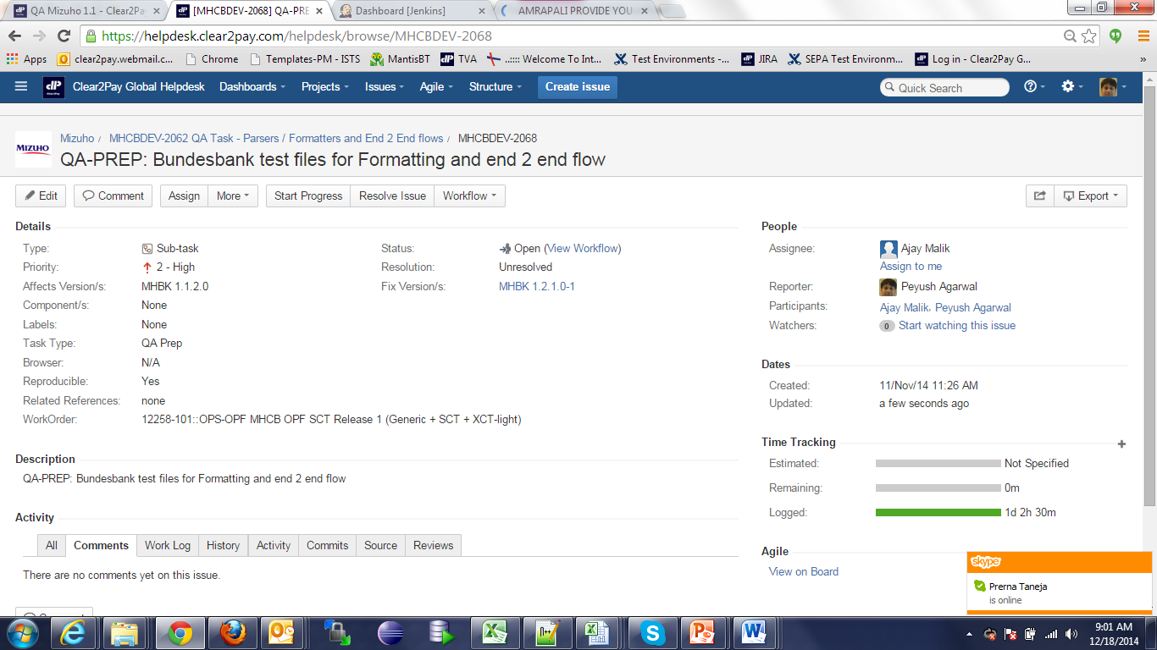
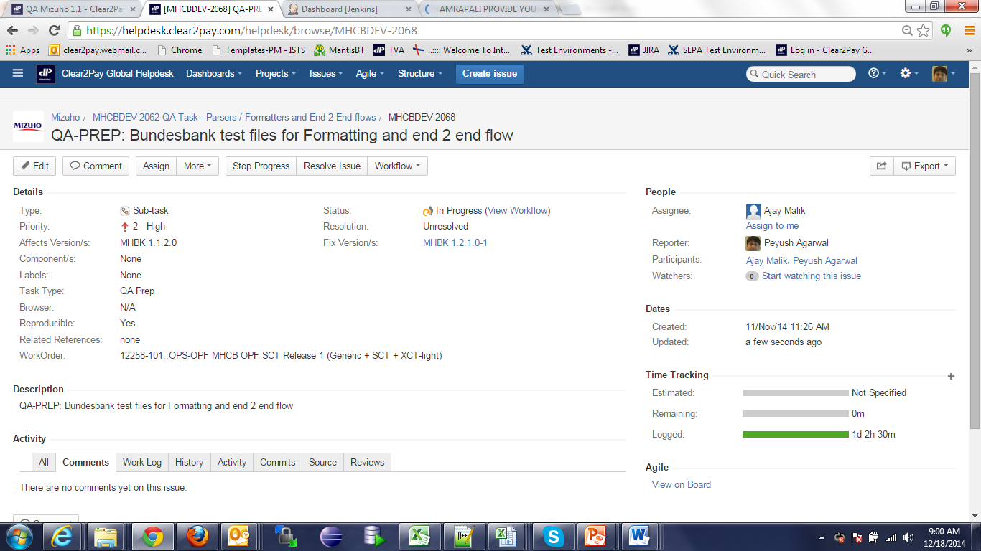
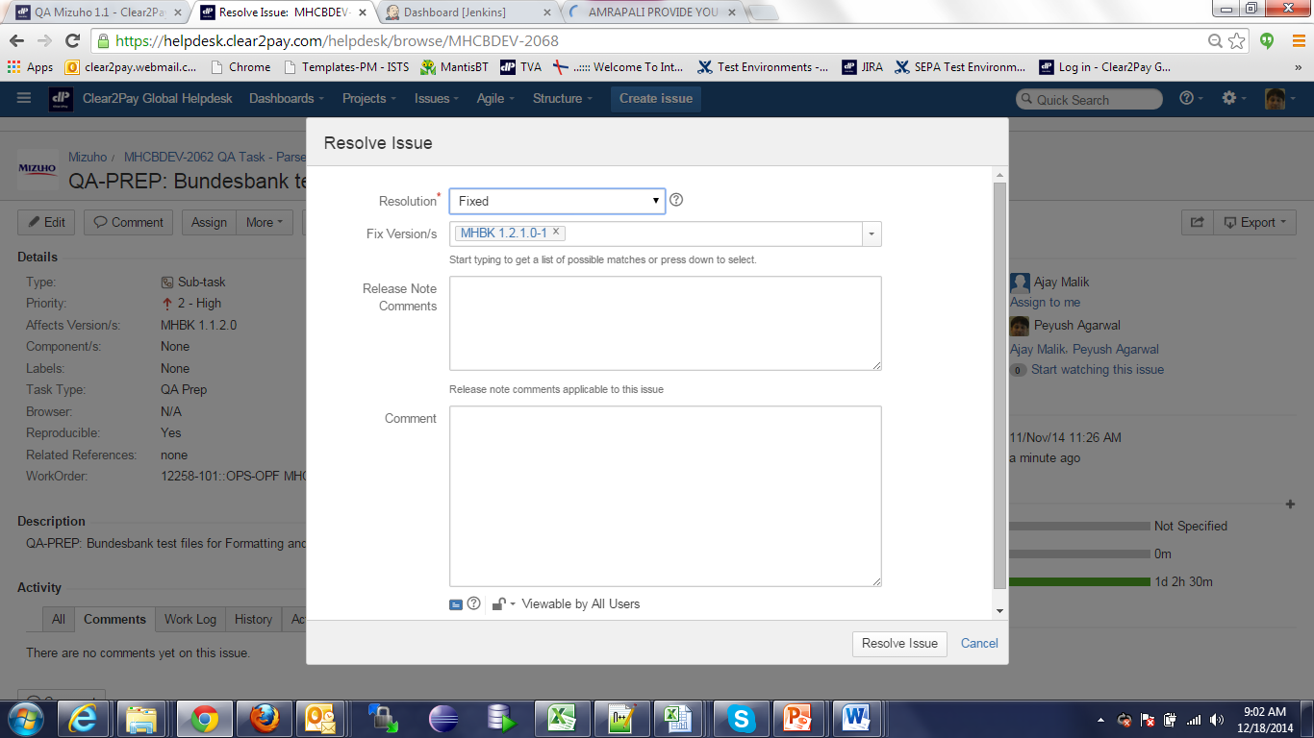
JIRA and different QA Task States
Once the Prep and Exe Sub task are created, we need to move the status of Task as shown below. Resource needs to move the stage of Prep Task once assigned by TL.
Click on Start Progress to move the status to “In Progress”
Click on Resolve Issue and following window will be displayed
Click on Stop Progress to move the status to “Open”
Select “Review” and status will be changed for Review

Slide 11
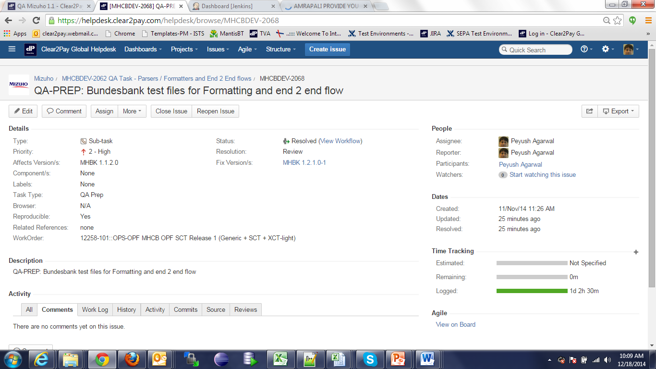
Closure of QA Task
Once the Prep and Exe Sub task are created, we need to move the status of Task as shown below. Resource needs to move the stage of Prep Task once assigned by TL.
Click on Close to move the status to “Close Issue” after Review comments have been incorporated

Slide 12
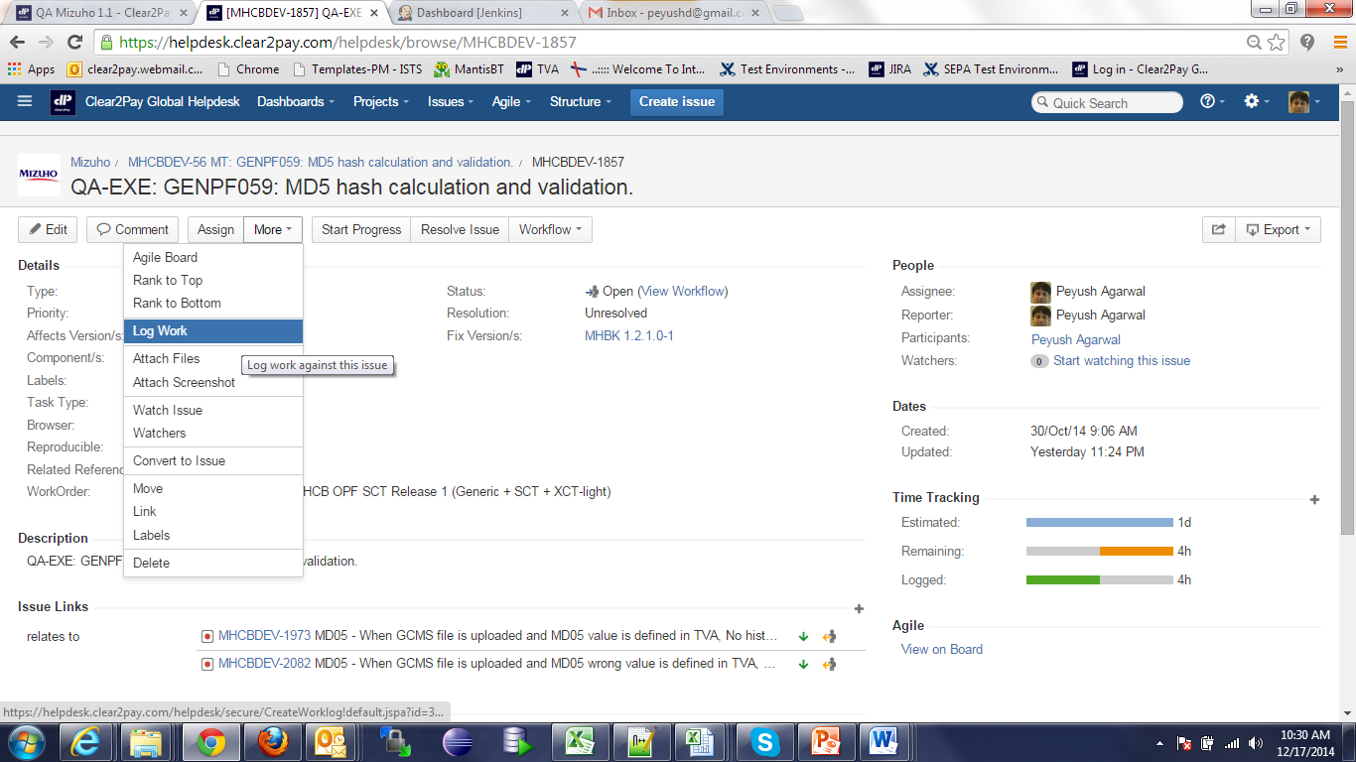
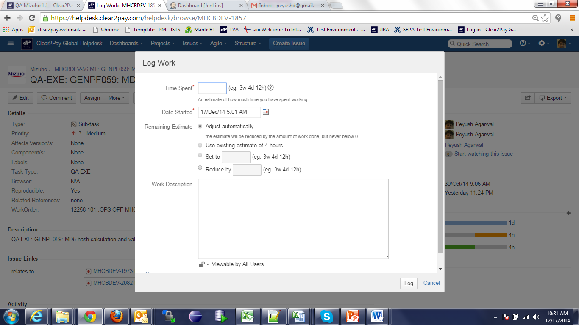
How to Log hours in JIRA
The above activity has to be done for all Project features for which Main task exists.
All resources are expected to fill the hrs. in JIRA for Prep and Exe QA sub-task on daily basis.
First snapshot below is when we click on more – Log work and second snapshot shows where we can enter time and log the efforts.

Slide 13
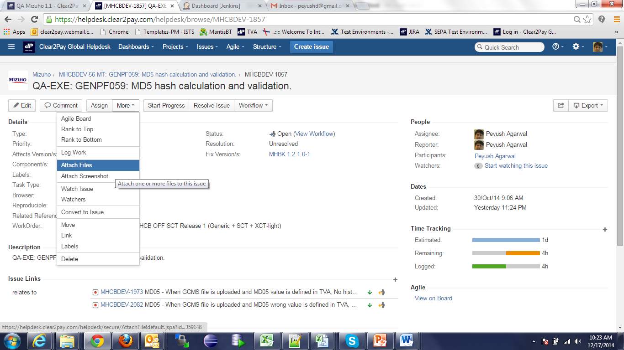
Linking of Defects with QA EXE Task
For QA Exe sub-task, all the defects that are logged during execution need to be linked to QA Exe task. Below is the snapshot on how to link the defects. Suppose a JIRA # MHCBDEV-100 is raised. Click on More - Link

Slide 14
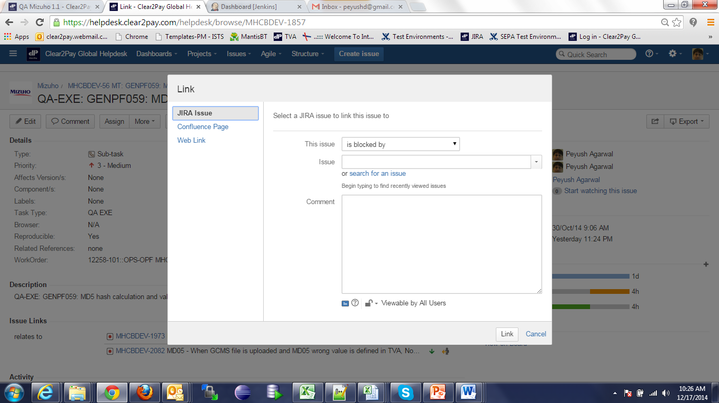
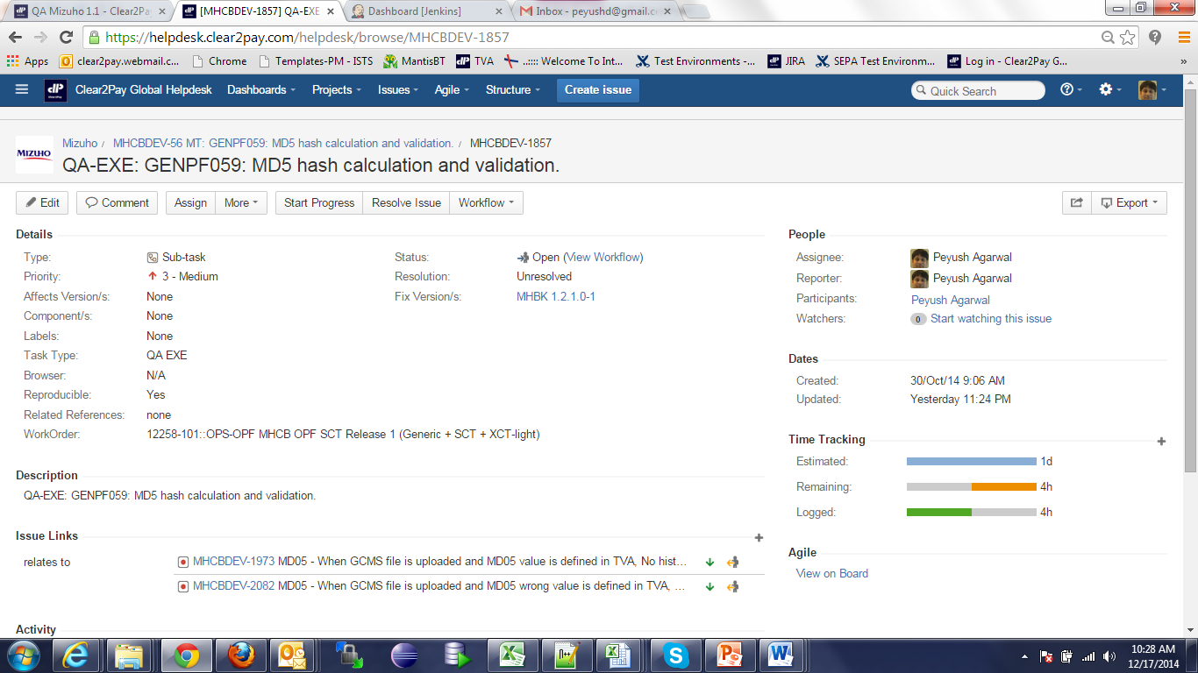
Linking of Defects in EXE Task
After clicking on Link, following screen should be displayed. Tester needs to select relevant stage from “This issue”, and enter MHCBDEV-100 in Issue. Put any comment land click on Link. It will display in QA Exe as shown in the snapshot below under Issue Links.

Slide 15
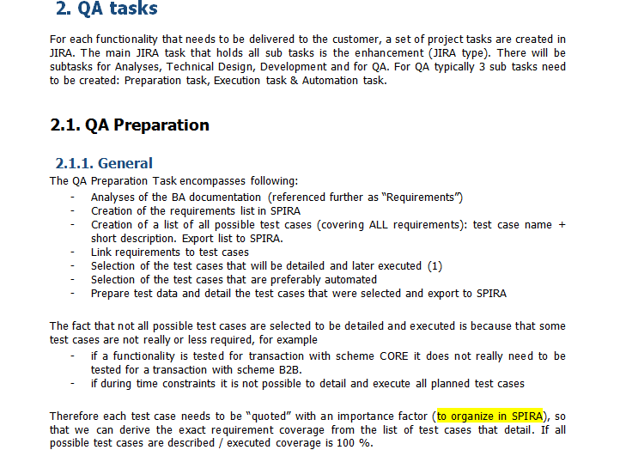
QA Guidelines
Following are the snapshots of QA Guidelines

Slide 16
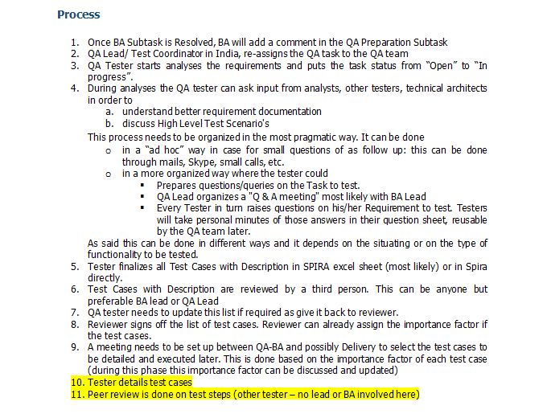
QA Guidelines

Slide 17
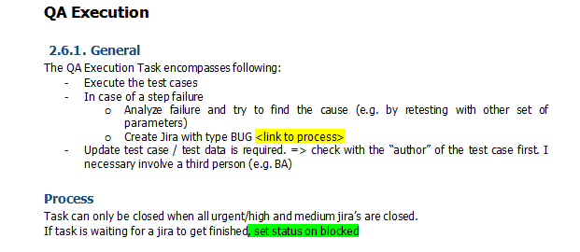
QA Guidelines

Slide 18
Bug Logging Guidelines
Tester can click on Create Issue to log a defect. Snapshots are shown in next slide but before that lets go through fields that need to be filled in by Testers:
Summary – A high level 1 liner description
Task Type – Defect
Severity – Depending on the defect
Priority – Depending on the defect
Related Reference – Any Use Case Reference, TC Number, any other document reference
Components – if it is Parser, Tester can select Parser
Affects version – depends on which version is Project on.
Description – Steps to reproduce, Actual and Expected Result and reference of attached files.
Assignee – Normally would be Dev Lead.
Work Order – Project Work order
System Logs

Slide 19
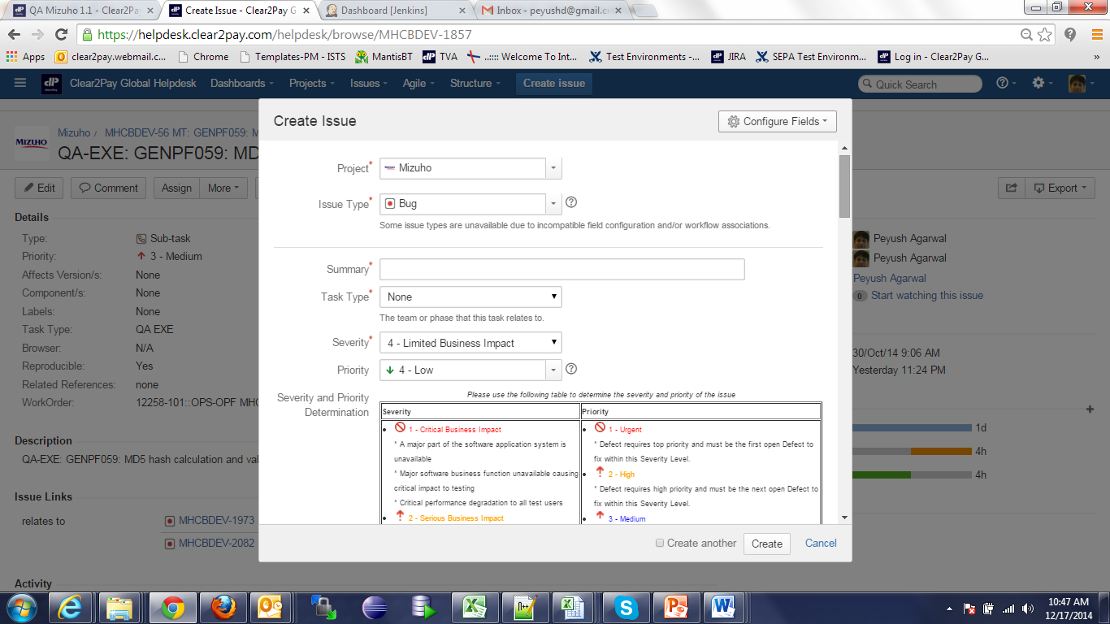
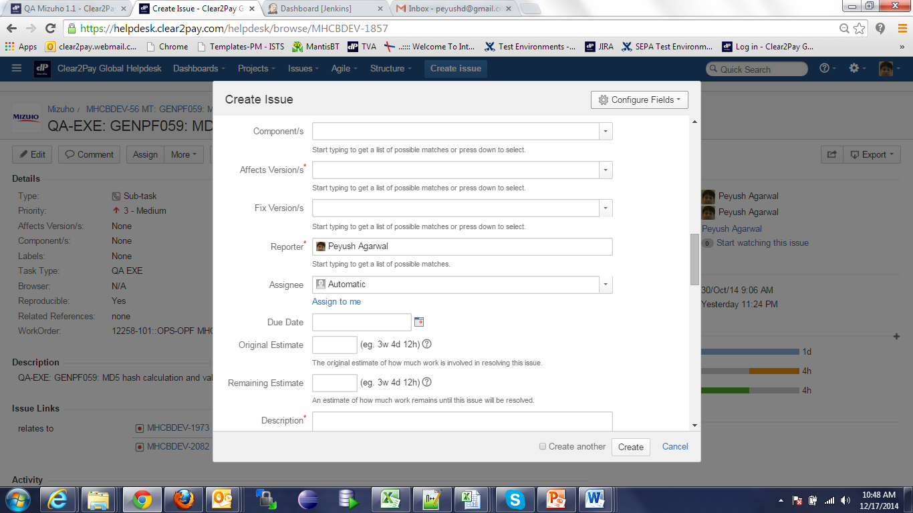
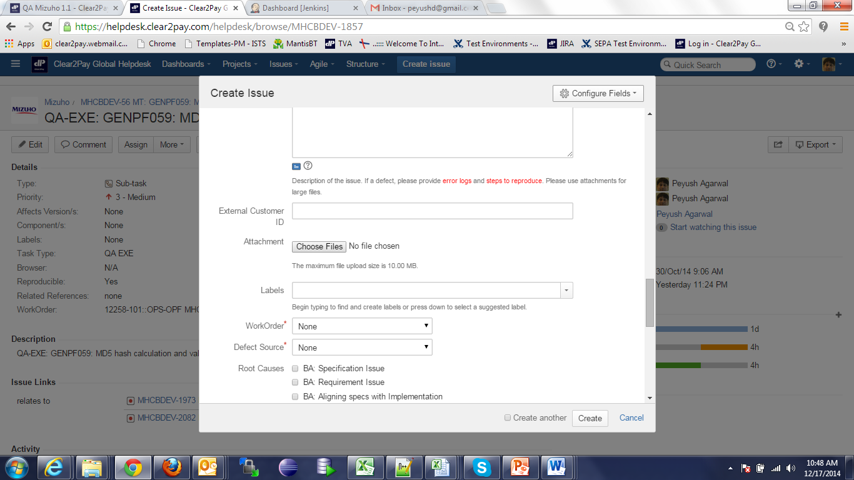
Bug Logging Guidelines

Slide 20
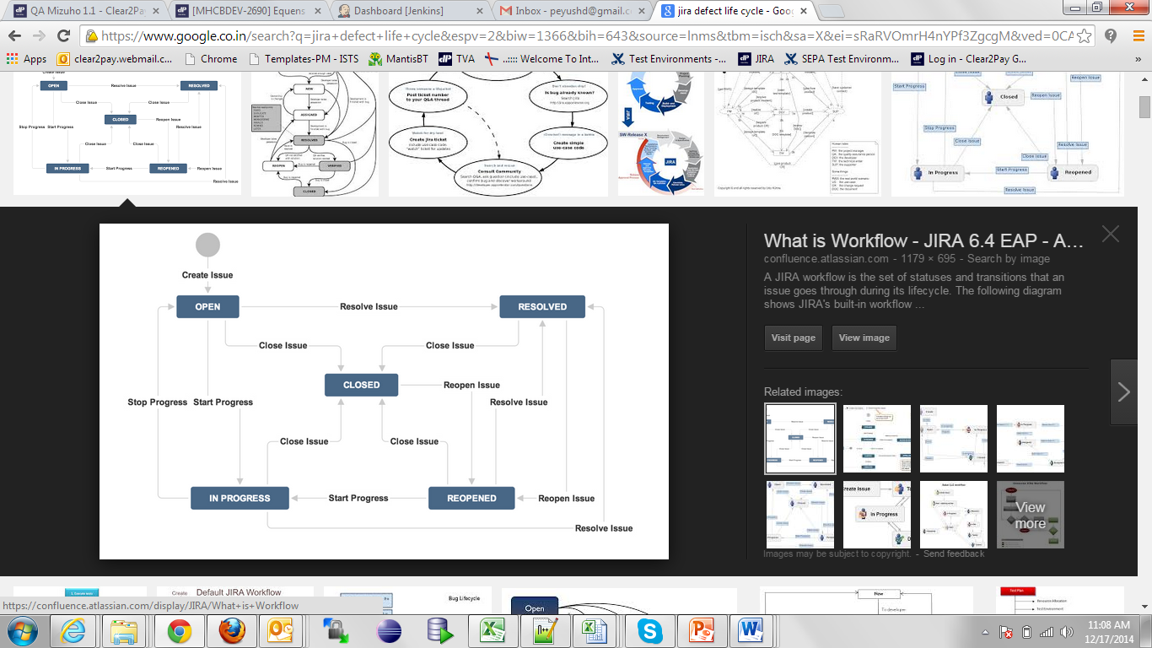
Bug Life Cycle
Following Bug Life Cycle to be followed in JIRA:

Slide 21
Revision
JIRA Structure
How to create QA Prep Task
How to create QA Exe Task
States of QA Prep and Exe Task
Linking of Defects with QA Exe Task
Bug Logging guidelines
Bug Life Cycle
4 types of Task (BA, DEV, QA Prep and Exe and TA)
Select QA Prep while creating sub task
Select QA Exe while creating sub task
How to change Task from one state to another
Important fields to be filled while reporting defect
How to link defect with QA Exe Task for monitoring
Change States from New to Close for Prep and Exe Task
New, Open, In Progress, Review, Closed

Slide 22

Question & Answers

Slide 23
EMEA – Headquarters
Brussels, Belgium
info@clear2pay.com
APAC
Sydney, Australia
info.apac@clear2pay.com
Americas
Atlanta, USA
info.americas@clear2pay.com
www.clear2pay.com

